Slide 1
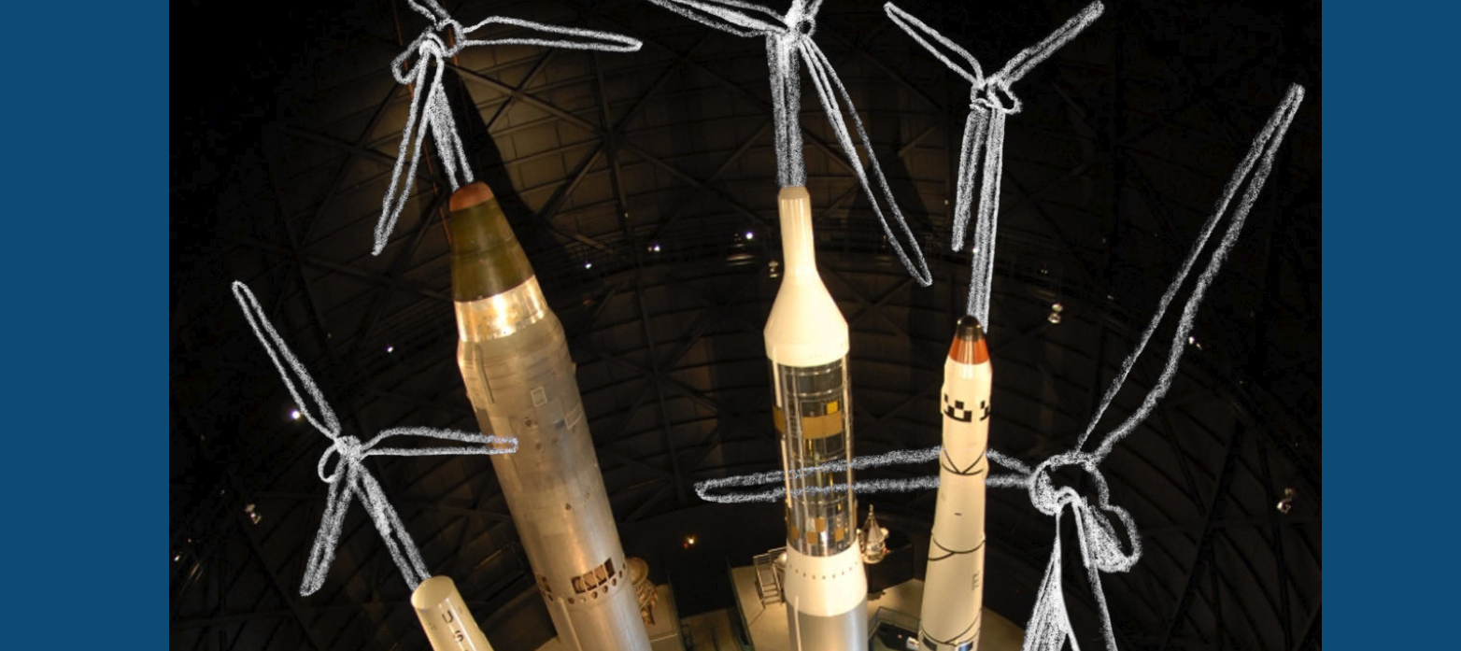

Slide 2
nuclearban.us/w2w

Slide 3
Warheads to Windmills
A Report
Looking at what it will take to address climate
What human and financial resources needed
What are we spending on nuclear weapons
How could one transition to the other
A Campaign
Building support for Green New Deal
Building support for Nuclear Ban Treaty
Using one as a means to achieve the other

Slide 4
Feeding two birds with one scone

Slide 5
3 Existential Threats
Climate catastrophe
Nuclear nightmare
Unsustainable inequality

Slide 7
Before and After COVID-19

Slide 8
After COVID…
3 global threats to humanity
Climate Crisis
Unsustainable Inequality
Nuclear Weapons
2 solutions
Green New Deal
Nuclear Ban Treaty
1 campaign
Warheads to Windmills

Slide 9
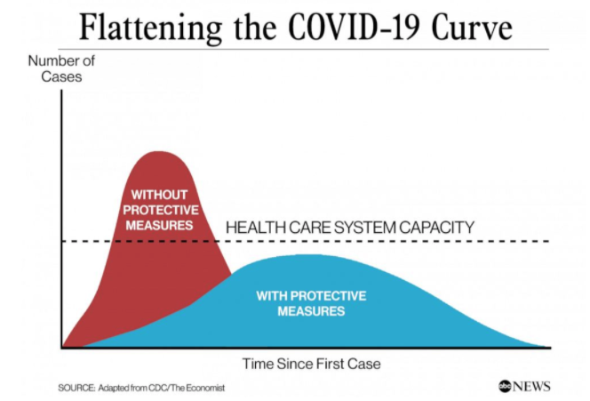

Slide 11
Unprecedented Investments
Treasury bonds purchase - $700 billion
Federal Reserve loans - $2.3 trillion
Re-purchase agreements - $2 trillion
Corporate debt backstop - $750 billion
Small business loans - $600 billion
Congress stimulus package - $2 trillion
Municipal government loans - $500 billion
New stimulus package - $480 billion

Slide 12
Unprecedented regulations
Closing of schools
Closing of restaurants
Closing of businesses
Stay at home orders
Closing of parks and playgrounds
Restrictions for entering grocery stores
Canceling major league sports

Slide 13
Re-Deployment of Workers
Use of War Production Act
Switch to making ventilators and masks
Switch to delivery services
Working from home
Zoom conferences

Slide 14
Appeal to the public
Wash hands for 20 seconds
Social distancing 6 feet
Stay home
Wear a mask in public

Slide 15
Global cooperation
Virus cases in any one country threaten the spread of infection to other countries
Countries with the worst sanitation, overcrowding and water quality need the most help
Can only control the virus by sharing information, research and supplies

Slide 16
How to flatten the curve?
Massive amounts of money
New rules and regulations
Converting workers and factories
Taking personal responsibility
Global cooperation

Slide 20
Flattening the Climate Curve
2℃

Slide 22
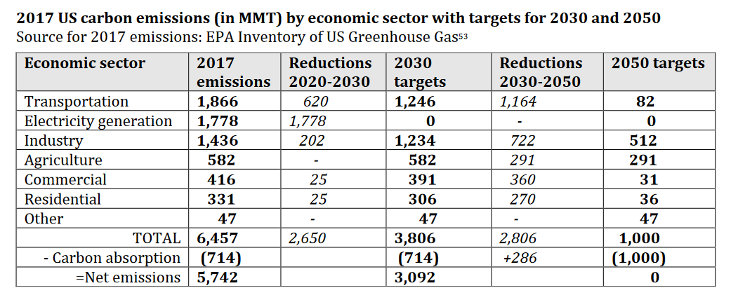
Carbon Reduction Targets
- From Warheads to Windmills, p. 17

Slide 23
Carbon Reduction Targets
- From Warheads to Windmills, p. 17

Slide 25
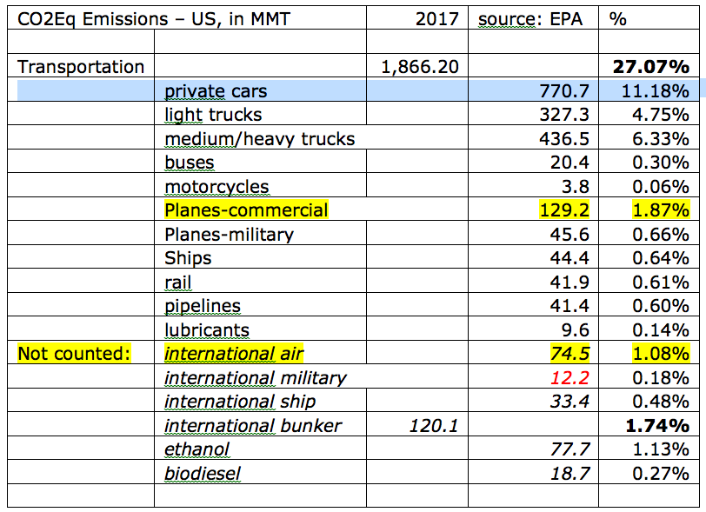

Slide 26
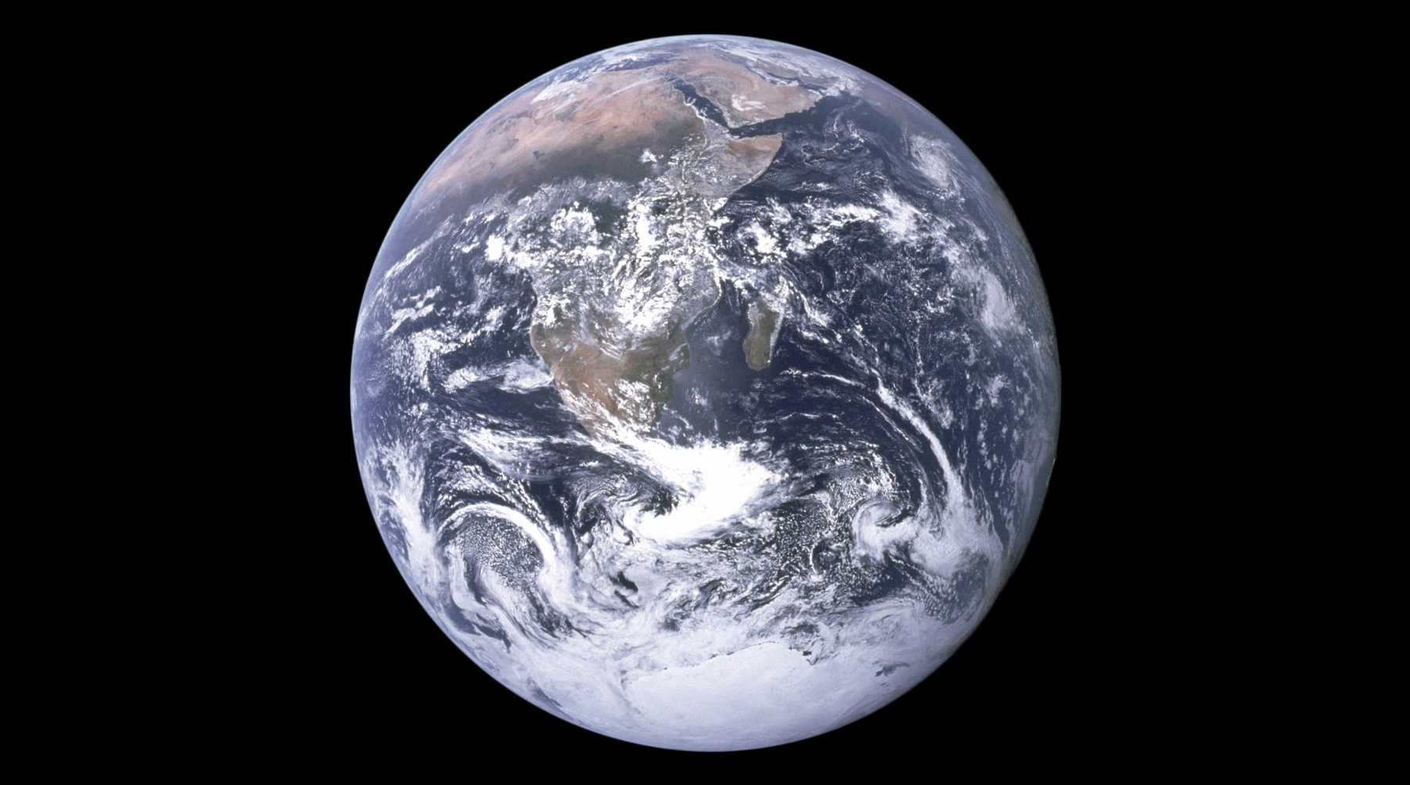

Slide 27
Transition to Electric Vehicles 2020-2030
Cars - millions | 2017 | 2018 | 2019 | 2020 | 2021 | 2022 | 2023 | 2024 | 2025 | 2026 | 2027 | 2028 | 2029 | 2030
total cars | 272 | 272 | 272 | 272 | 272 | 272 | 272 | 272 | 272 | 272 | 272 | 272 | 272 | 272
gas - new | 17 | 17 | 17 | 17 | 16 | 15 | 14 | 12 | 10 | 8 | 6 | 4 | 2 | 0
electric - new | 0.2 | 0.36 | 0.5 | 0.7 | 1 | 1.4 | 2 | 2.8 | 3.9 | 5.5 | 7.6 | 10.5 | 14.5 | 17.5
percent growth |  | 80% | 39% | 40% | 43% | 40% | 43% | 40% | 39% | 41% | 38% | 38% | 38% | 21%
total gas | 271.8 | 271.4 | 270.9 | 270.2 | 269.2 | 267.8 | 265.8 | 263.0 | 259.1 | 253.6 | 246.0 | 235.5 | 221.0 | 203.5
total electric | 0.2 | 0.36 | 0.6 | 1 | 2 | 3.4 | 5.4 | 8.2 | 12.1 | 17.6 | 25.2 | 35.7 | 50.2 | 67.7
% electric | 0.072 | 0.13 | 0.22 | 0.36 | 0.73 | 1.25 | 1.98 | 3.01 | 4.44 | 6.47 | 9.26 | 13.12 | 18.45 | 24.84
CO2 MMT | 1550 | 1550 | 1550 | 1542.6 | 1535.2 | 1525 | 1510.2 | 1489.7 | 1461.0 | 1420 | 1364.7 | 1287 | 1180.8 | 1053.1
CO2 reduction |  |  |  | 7.3529 | 14.705 | 25 | 39.705 | 60.294 | 88.970 | 129.4 | 185.29 | 262.5 | 369.11 | 496.88

Slide 28
Transition to Renewable Electricity 2020-2030
Renewable Electricity (Generating Capacity) | 2017 | 2018 | 2019 | 2020 | 2021 | 2022 | 2023 | 2024 | 2025 | 2026 | 2027 | 2028 | 2029 | 2030
TOTAL capacity GW | 1,072.00 | 1,200.00 | 1,200.00 | 1,200.00 | 1,200.00 | 1,200.00 | 1,200.00 | 1,200.00 | 1,200.00 | 1,200.00 | 1,200.00 | 1,200.00 | 1,200.00 | 1,200.00
fossil fuels and biomass GW | 736.00 | 792.00 | 844.20 | 813.50 | 756.60 | 677.10 | 594.10 | 509.10 | 422.10 | 335.10 | 248.10 | 161.10 | 74.10 | 0.00
nuclear GW | 99.00 | 99.00 | 98.00 | 95.00 | 92.00 | 92.00 | 92.00 | 91.00 | 90.00 | 89.00 | 88.00 | 87.00 | 86.00 | 85.00
Hydro | 79.80 | 79.80 | 79.80 | 79.80 | 79.80 | 79.80 | 79.80 | 79.80 | 79.80 | 79.80 | 79.80 | 79.80 | 79.80 | 79.80
Wind | 87.60 | 96.40 | 100.00 | 113.60 | 135.50 | 170.00 | 205.00 | 240.00 | 275.00 | 310.00 | 345.00 | 380.00 | 415.00 | 450.00
Solar | 27.00 | 64.20 | 76.20 | 91.20 | 121.20 | 156.20 | 191.20 | 226.20 | 261.20 | 296.20 | 331.20 | 366.20 | 401.20 | 436.20
renewables GW | 194.40 | 242.20 | 257.80 | 291.50 | 351.40 | 430.90 | 513.90 | 599.90 | 687.90 | 775.90 | 863.90 | 951.90 | 1,039.90 | 1,122.90
% renewable | 18.13 | 20.18 | 21.48 | 24.29 | 29.28 | 35.91 | 42.83 | 49.99 | 57.33 | 64.66 | 71.99 | 79.33 | 86.66 | 93.58
FF reduction |  |  |  | 30.70 | 87.60 | 167.10 | 250.10 | 335.10 | 422.10 | 509.10 | 596.10 | 683.10 | 770.10 | 844.20
CO MMT |  |  | 2,000.00 | 1,914.12 | 1,780.24 | 1,593.18 | 1,397.88 | 1,197.88 | 993.18 | 788.47 | 583.76 | 379.06 | 174.35 | 0.00
CO reduction |  | 0.00 |  | 85.88 | 219.76 | 406.82 | 602.12 | 802.12 | 1,006.82 | 1,211.53 | 1,416.24 | 1,620.94 | 1,825.65 | 2,000.00

Slide 29
Green New Deal
Immediate Priorities – by 2030
100% Renewable Electricity
Only electric vehicles for sale
All new buildings fossil-free
Complete ban on HFCs
Longer-term Priorities – by 2050
5. Transformation of agriculture
Transformation of steel, cement and other industries
Planting of 10 billion trees

Slide 30
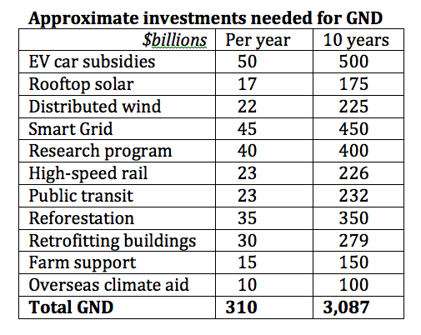

Slide 31
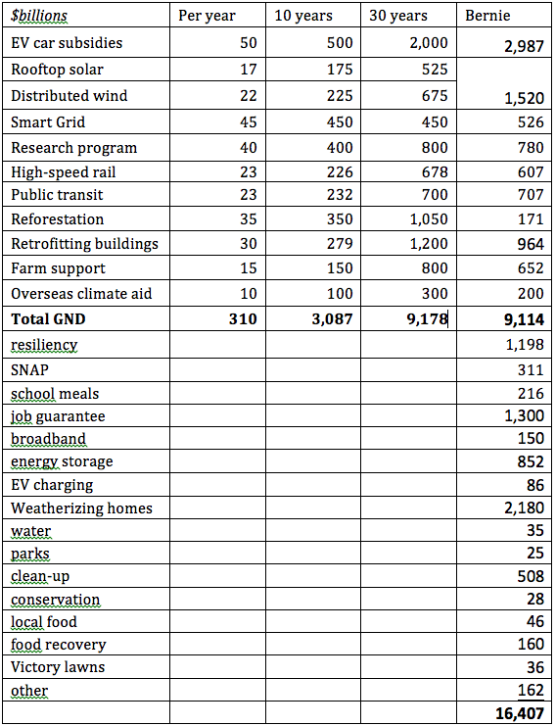

Slide 33
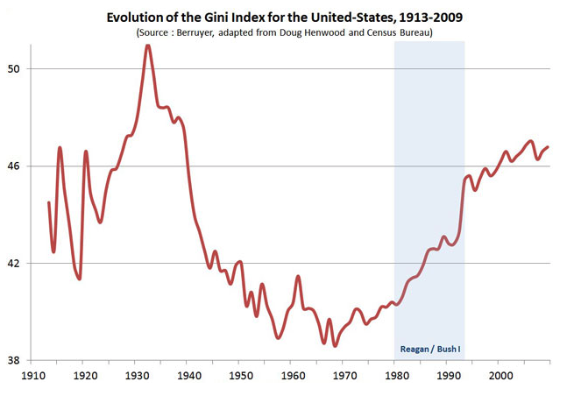

Slide 34
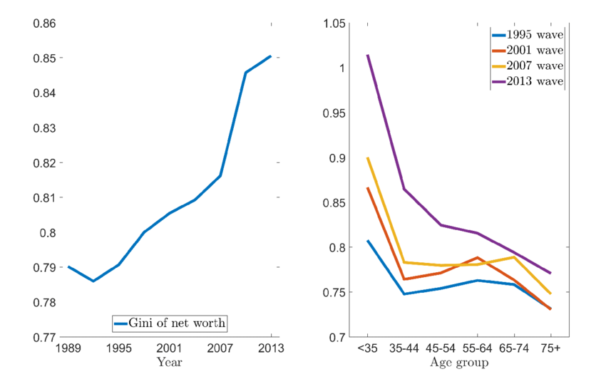

Slide 35
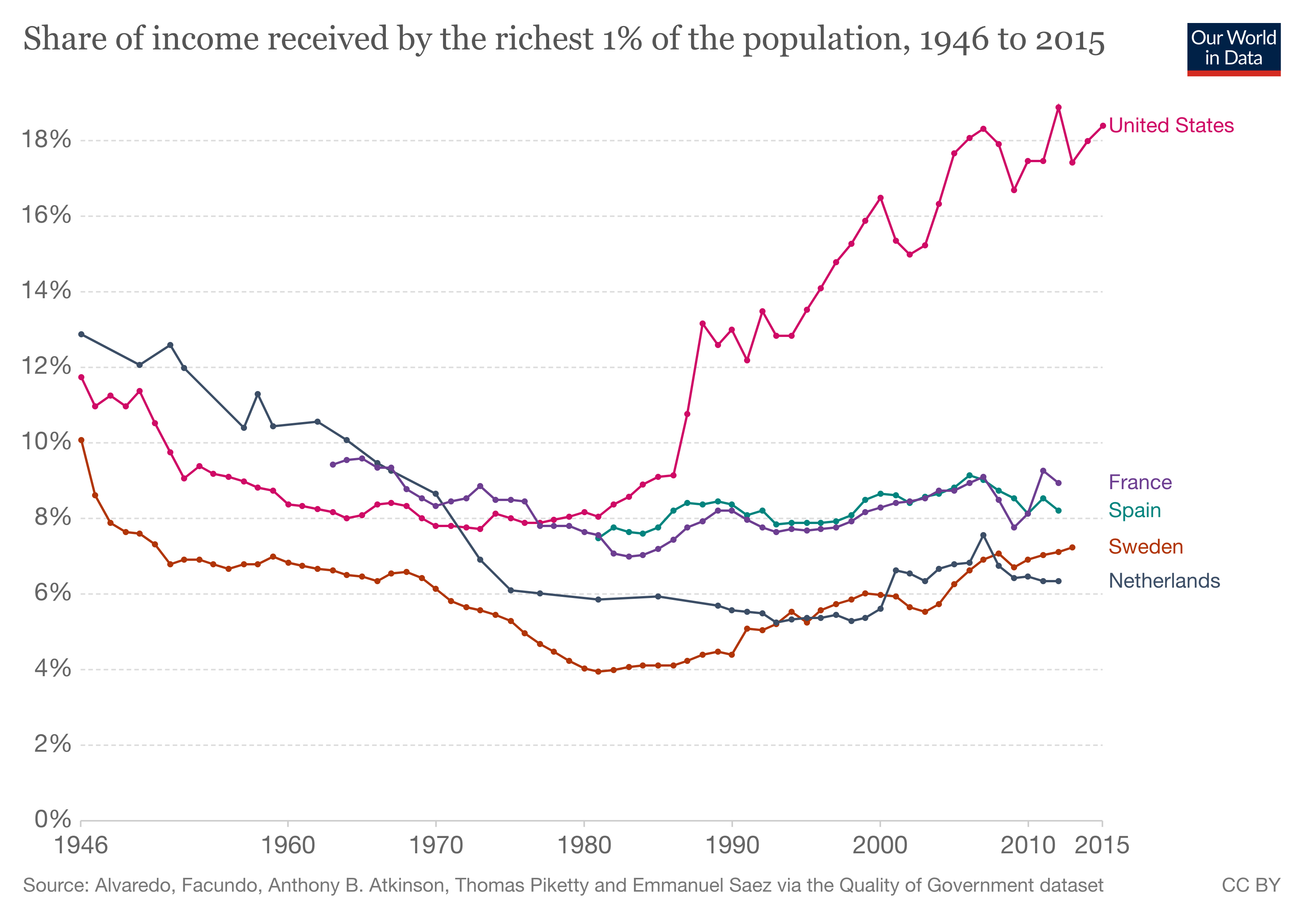

Slide 36
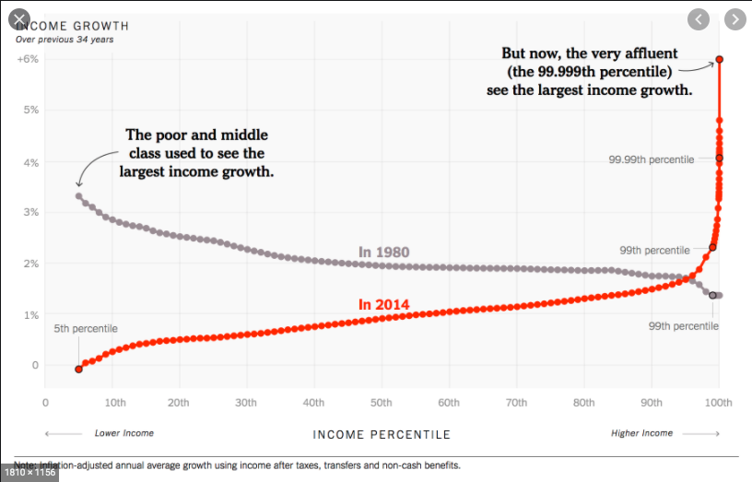

Slide 37
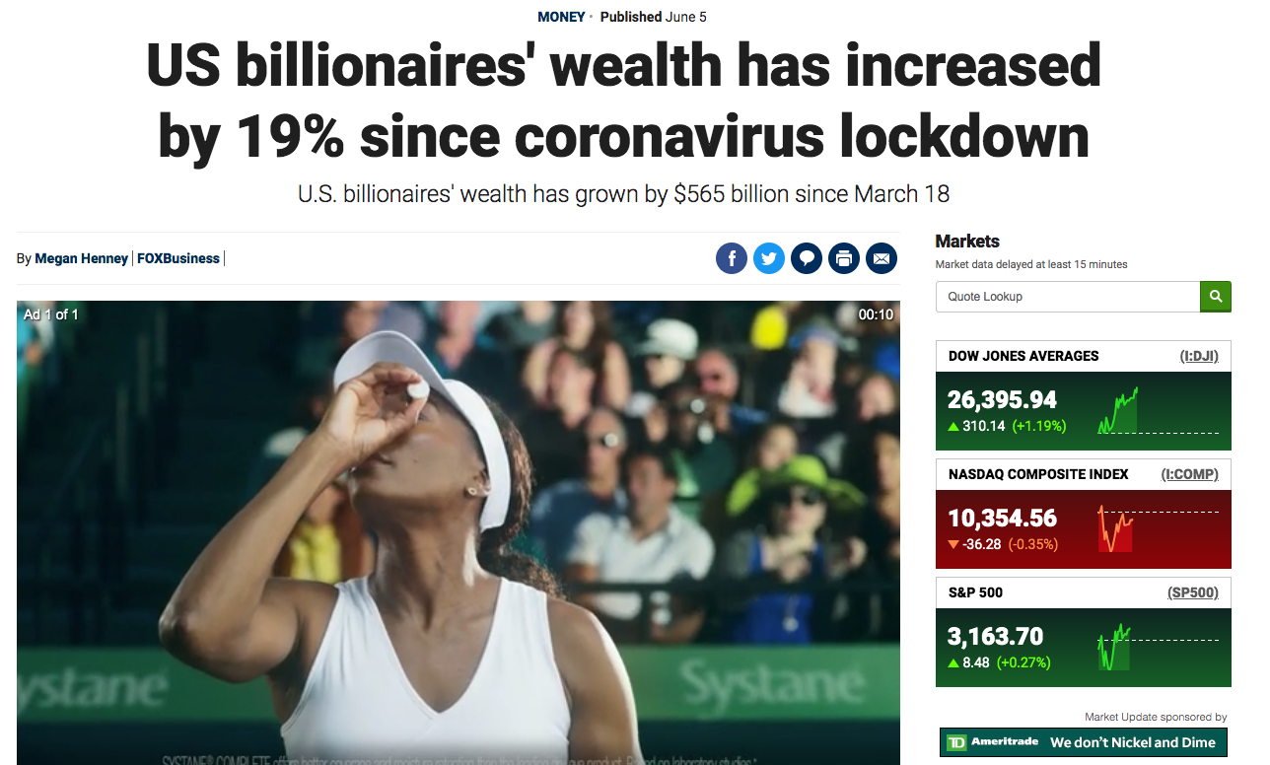

Slide 38
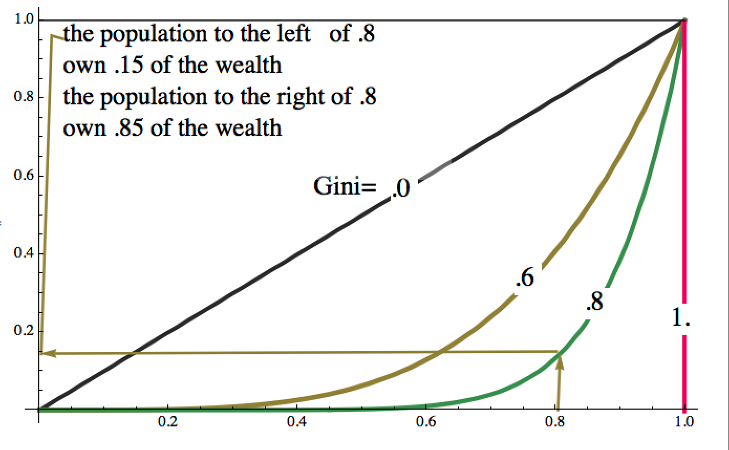

Slide 39
Flattening the Inequality Curve
Massive amounts of money
New rules and regulations
Converting workers and factories
Taking personal responsibility
Global cooperation

Slide 40
Money
To create jobs
Access to healthcare
Better housing
Education without debt
Public transportation
Neighborhoods and infrastructure

Slide 41
Legislation

Slide 42
How to flatten the curve?
Massive amounts of money
New rules and regulations
Converting workers and factories
Taking personal responsibility
Global cooperation

Slide 43
How to flatten the curve?
Massive amounts of money
New rules and regulations
Converting workers and factories
Taking personal responsibility
Global cooperation

Slide 44
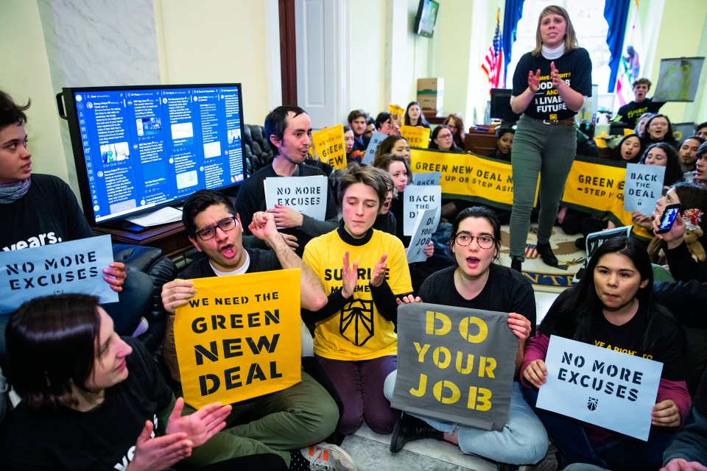

Slide 45
Call to Action #2
Tell Joe Biden:
We need to cut our carbon emissions in half by 2030.
That’s what the science says.
That’s what the IPCC says.
That’s what our young people say.
It’s their future that’s at stake!
What are you going to do to make sure we meet the IPCC’s 2030 target?

Slide 46
Hiroshima, 1945

Slide 50
Flattening the Nuclear Curve
1 explosion
available burn beds
No explosion

Slide 51
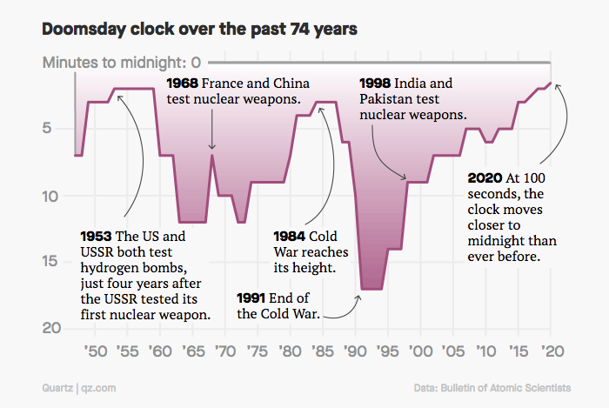

Slide 52
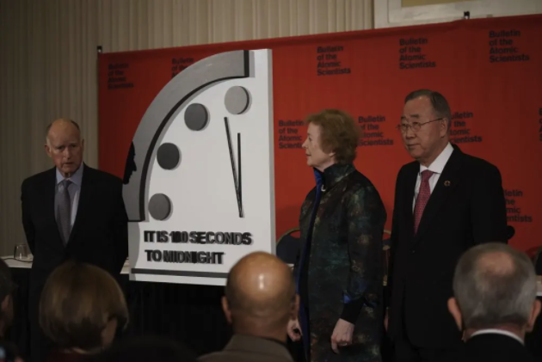
Former CA Gov Jerry Brown, Former Irish PM Mary Robinson and Former UN S-G Ban Ki-Moon unveil the 2020 “Doomsday Clock,” January, 2020

Slide 59
Call to Action #3
Ask members of Congress to…
Co-sponsor H.Res. 302:
https://www.congress.gov/bill/116th-congress/house-resolution/302/
And sign ICAN Pledge:
https://pledge.ican.org/

Slide 66
Call to Action #4
Boycott and Divest Fossil Fuels AND Nuclear Weapons
Dontbankonthebomb.com
Gofossilfree.org

Slide 69
Green New Deal
Massive amounts of money
New rules and regulations
Converting workers and factories
Global cooperation and personal sacrifice
Internationally
China
Russia
India
Europe

Slide 70
Changing US Budget Priorities
Money earmarked
for nuclear weapons
over next 30 years
Money needed to address climate change

Slide 72
Jobs for death
or
Jobs for life

Slide 73
Countries with nuclear weapons and their key allies
Largest carbon emitting countries
USA
Russia
China
India
Pakistan
UK
France
Israel
North Korea
Germany
Italy
Turkey
Belgium
Netherlands
China
USA
EU (Germany, France, UK, Italy, Belgium, Netherlands…)
India
Russia
Japan
Canada
South Korea
Australia
Saudi Arabia
Pakistan

Slide 75
Call to Action #5
Ask members of Congress to support H.R.2419
https://www.congress.gov/bill/116th-congress/house-bill/2419/
Join the Warheads to Windmills campaign!
Nuclearban.us/join-the-campaign/

